Slide 1
IC101 Digital Fabrication
Department of Mechanical Engineering
Indian Institute of Technology Bhilai

Slide 2
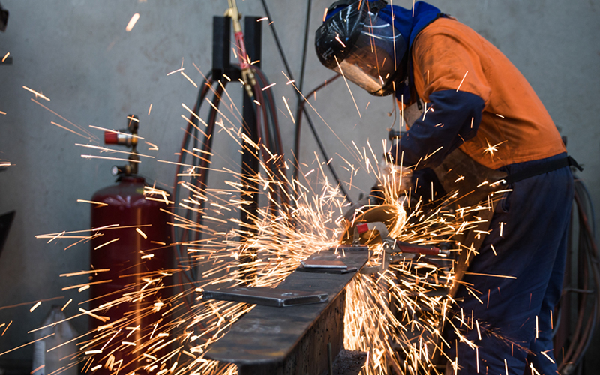
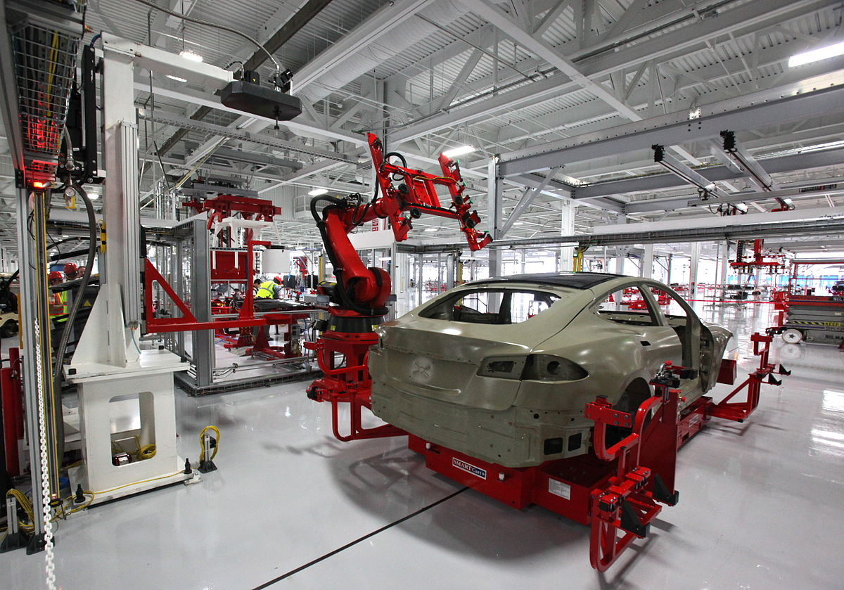
Fabrication and Manufacturing
to make by art or skill and labor; construct:
Manufacturing is the processing of raw materials or parts into finished goods through the use of tools, human labor, machinery, and chemical processing

Slide 3
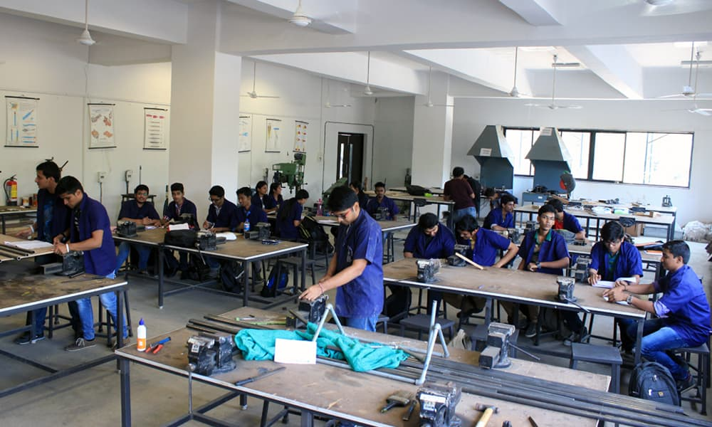

Slide 4
Schedule of classes
Week | Lectures (11:30 – 13:00) | Lab (14:30 – 17:30)
 | Mon | Tue | Thu | Sat
Week 1 |  | Modelling
Week 2
Week 3
Week 4
Week 5
Week 6 |  | DIY
Week 7
Week 8
Week 9
Week 10
Week 11 - Week 12 (2 weeks) | Project

Slide 5
Evaluation
Quiz (T1)– 5%
Quiz (T2)– 5%
Quiz (T3)– 10%
Modelling
Assignments – 24% (1 week) = 4X6
Final Assignment / Exam of 3D modelling – 20 %
DIY Part (Welding/Cutting/Machining)
Report – 16% (1 week) = 4X4
Viva/written exam – 20%

Slide 6
Manufacturing Processes
Subtraction
Riveting
Shape change (forming)
Forging
Addition
Grinding
Net/Near-net production
3D printing
Drilling
Welding
Rolling
Casting
Mechanical Joint
Milling
Turning
Drawing

Slide 7

Where did it begin???
Necessity is the MOTHER of invention
Notes:
Where do you think it would have begun
It all begun when man was not satisfied with the naturally occurring shapes and profiles.

Slide 8

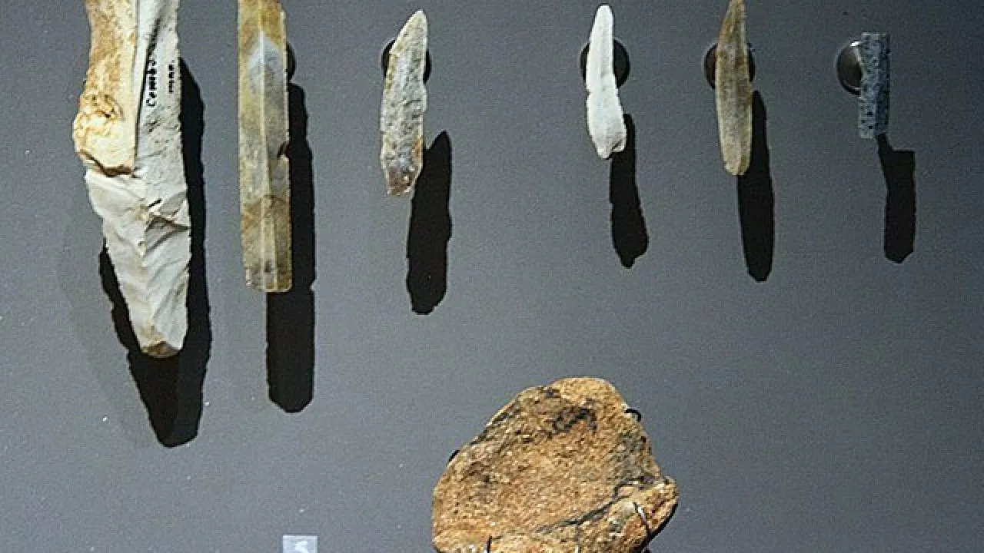
Where did it begin???
Notes:
Two factors majorly influenced the development of fab: materials and the source of power available.
Eg. Forging, Sugarcane crushing machine.

Slide 9
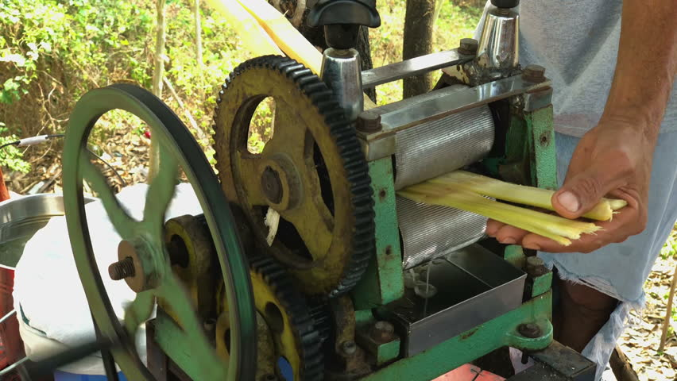

Slide 10
Manufacturing over ages

Slide 11
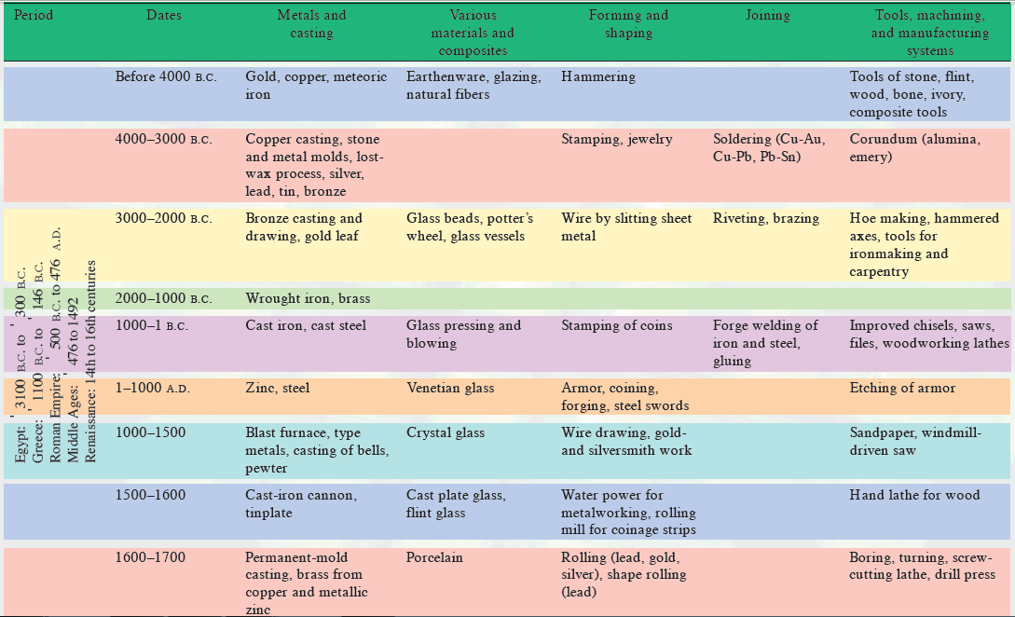

Slide 12
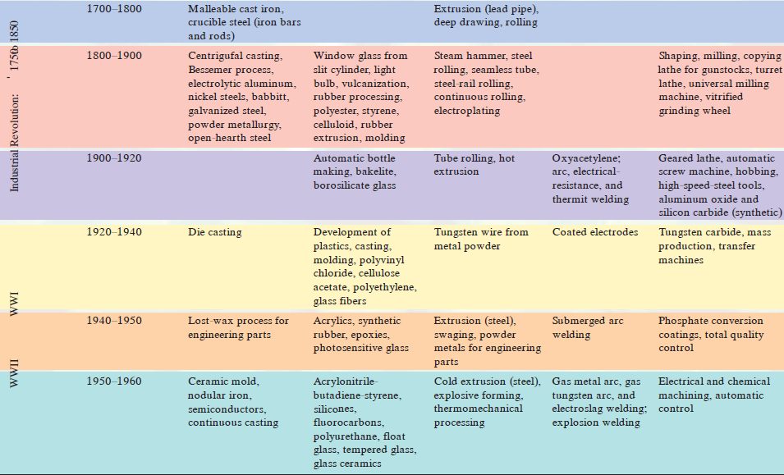
Notes:
Left in 1800

Slide 13
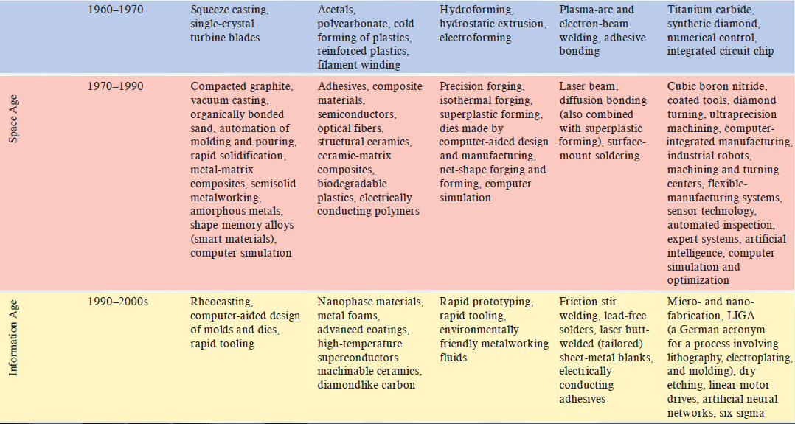
Notes:
Currently in Big Data age (Since 2001) sub group of info age.

Slide 14
Digital part???
Notes:
For this we should see our conventional form of manufacturing before the advent of Digital mfg.

Slide 15
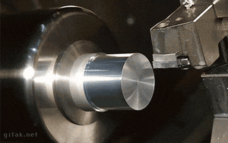
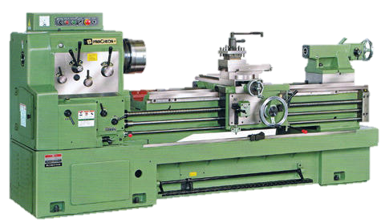
Conventional Turning centre

Slide 16
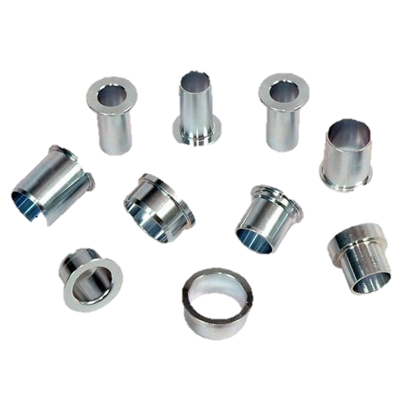

Slide 17
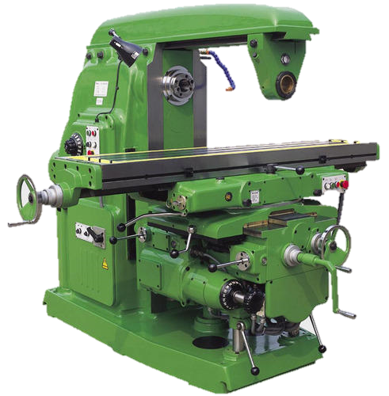
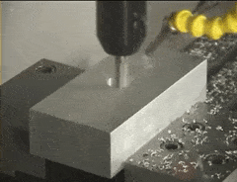
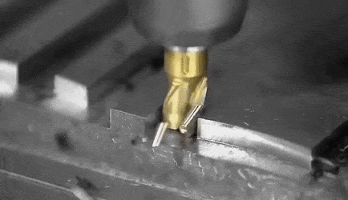
Milling machine
Notes:
Now what is the drawback? The tables have linear control. Controlling curve profile becomes tedious.

Slide 18
Computer Numerical Control
NEED
manufacture complex curved geometries in 2D or 3D by mechanical means
extremely expensive
Includes complex jigs to drive the cutter motions
Machining components with repeatable accuracy
Automate the manufacturing process
Unmanned machining operations

Slide 19
Advantages
Versatile
Less errors
Cheap
Complex geometries can be produced without any hassle

Slide 20
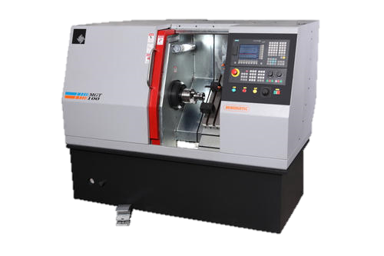
Difference
Conventional
CNC
Drive – mechanical
Change of operation is tedious
Drive – servo control
Just by a change of program
Notes:
Advantage of servo – one should know the reason for it.

Slide 21
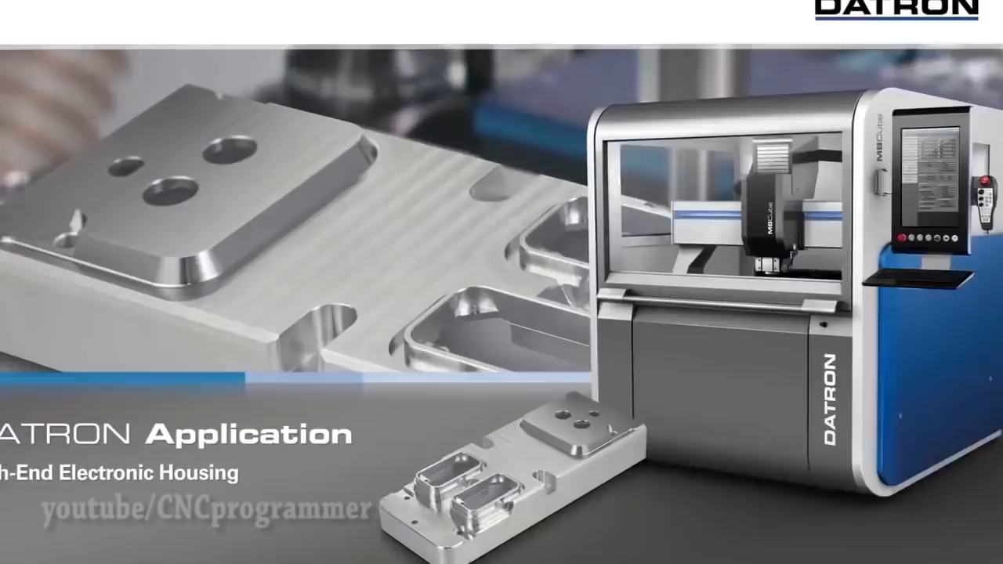
Operation of a CNC machine

Slide 22
Types of CNC
CNC
Motion type
Point to point
Continuous
Feedback
Open loop
Closed loop
Power source
Electric
Hydraulic
Pneumatic
Positioning
Incremental
Absolute

Slide 23
different methods of CNC Programming
Conversational Programming
CAM Software
G-Code Programming

Slide 24
Cheat sheet of G-codes
The 10 g-codes are:
G01 to move while cutting
G00 to move rapidly through air
F to control feed rate in a cut
S, M03, and M07/M08 to control your spindle
M08 to switch on coolant
M05 to stop the spindle, M09 to stop coolant

Slide 25
Programming the machines – G code
Each line of program -> Block
Sequence and format of words:
N3 G2 X+1.4 Y+1.4 Z+1.4 I1.4 J1.4 K1.4 F3.2 S4 T4 M2
destination coordinates
sequence no
dist to center of circle
tool
spindle speed
feed rate
preparatory function
miscellaneous function

Slide 26
Some essential G-codes
G00 Rapid traverse
G01 Linear interpolation
G02 Circular interpolation CW
G03 Circular interpolation CCW
G20 Imperial unit
G21 Metric unit
G90 Absolute system
G91 Incremental system
G94 Feed per minute
G95 Feed per revolution
Some essential M-codes
M00 Program Stop
M03 Spindle on CW
M04 Spindle on CCW
M05 Spindle stop
M06 ATC
M08/M09 Coolant on/off
M10/M11 Vice Open/close
M30 Program stop and rewind
M98 Sub-program call
M99 Sub-program end and return

Slide 27
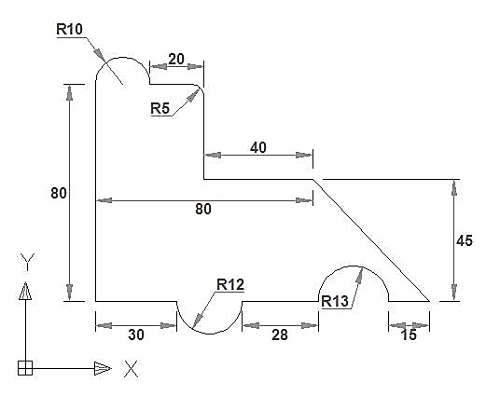
Example
Feed: 30 mm/min
Speed: 5000 rpm

Slide 28
Few things to keep in mind
What’s the difference between machines zero, work zero, and part zero?

Slide 29
List of experiments
DIY
Modelling and printing
Machining
Manual coding (Turning)
Computer-Aided coding (Milling)
Laser cutting
Moulding/Casting
Welding
Solid modelling
Additive manufacturing (3D print)

Slide 30

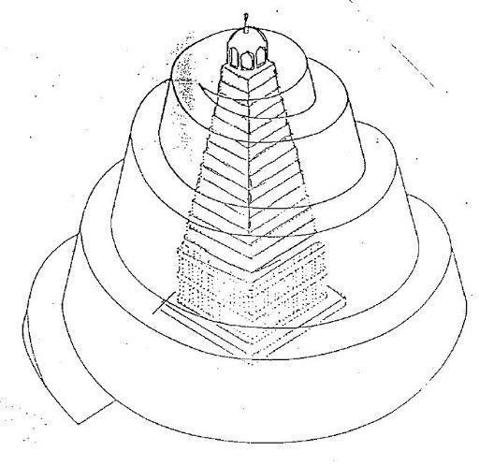

Slide 31
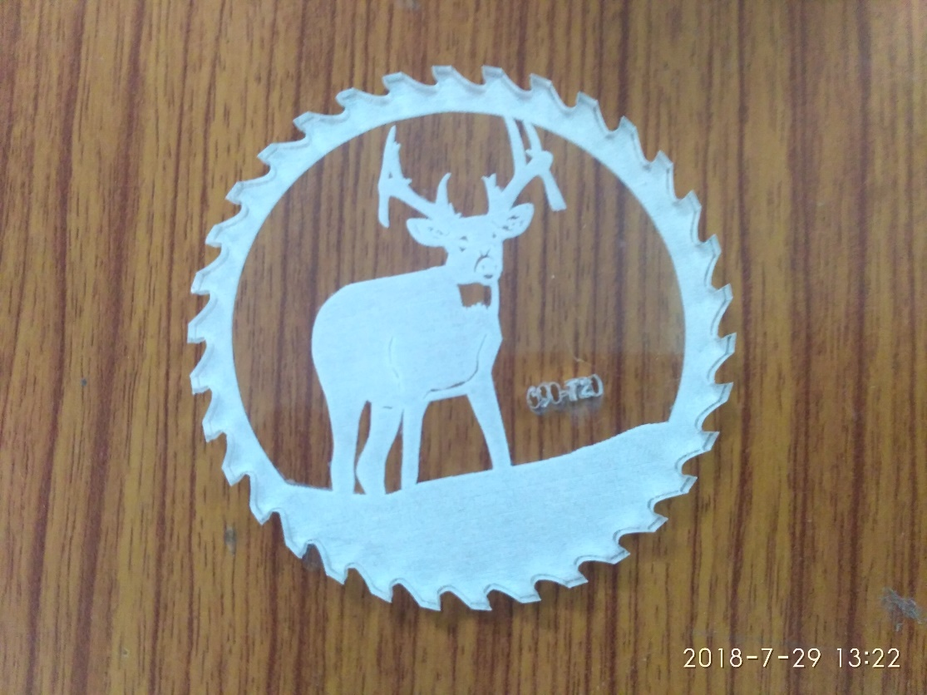
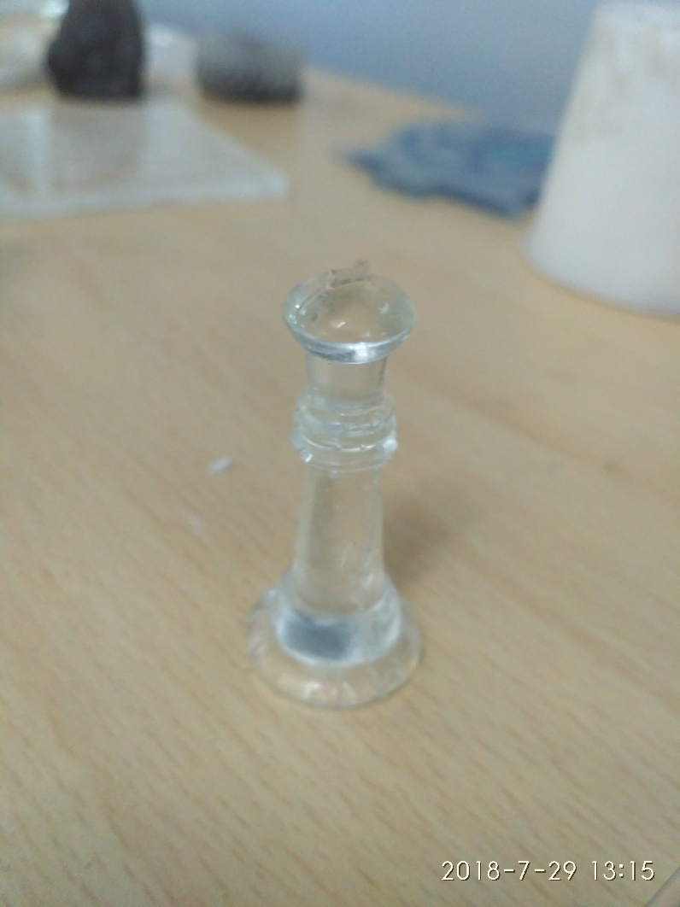


Slide 32
